Slide 1
Kad Zebras Deg
Bar / RESTAURANT
Computer Science project
DMAI0914 | Group 3

Slide 2
Group 3
Members:
Ionut Danci-Bumbea
Janis Indrans
Leonard Hirja
Nikita Cimaskevic
Richard Retezi

Slide 3

Introduction:
Name: Kad Zebras Deg
Founded: 07.01.2014
Location: Latvia, Riga
Owner and manager: Renars Bents
Type of business: Bar & Restaurant Industry
Translation of logo: Bar “When Zebras Burn”

Slide 4
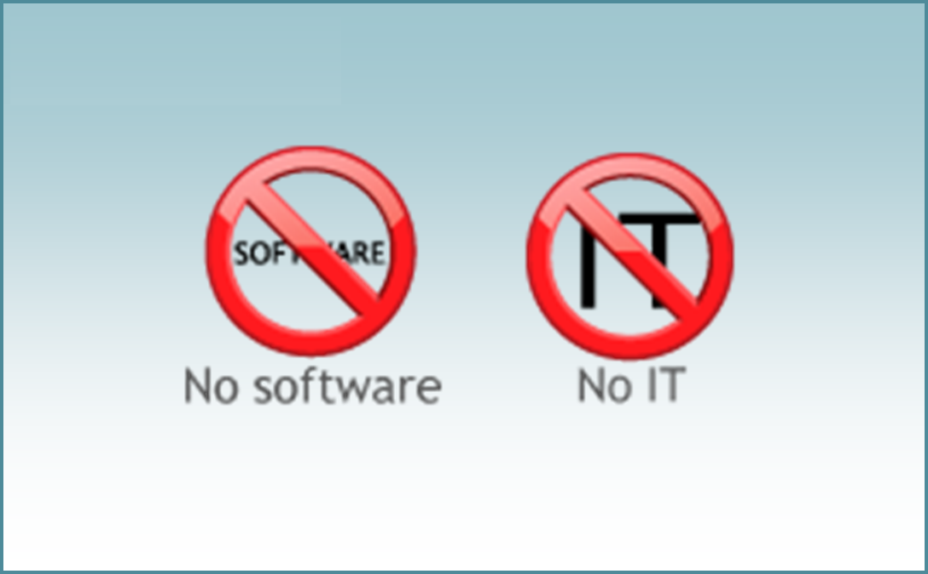
How should we create a system for newly established business?

Slide 5
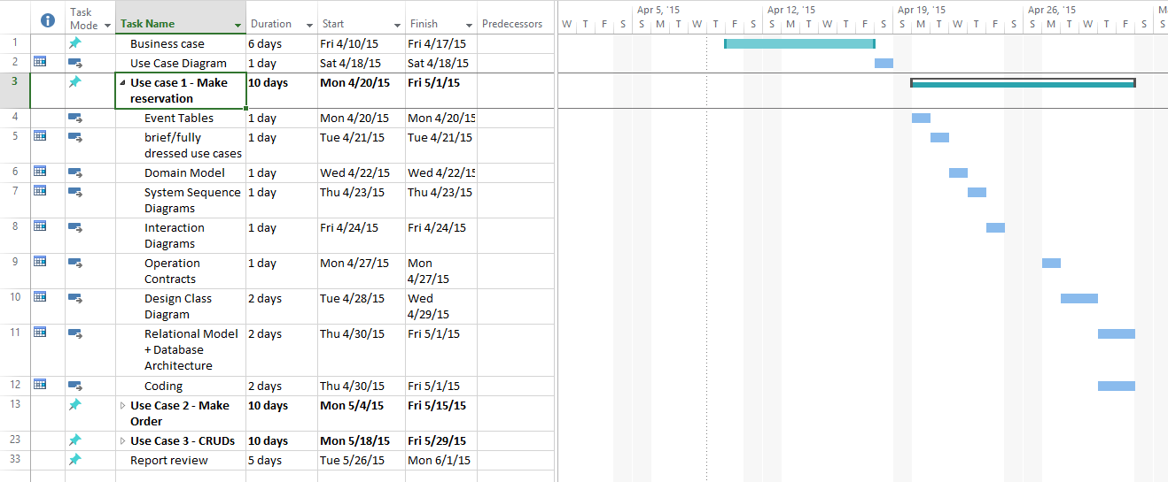
Project Plan

Slide 6

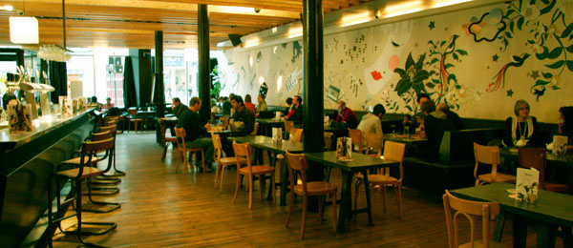
Which tables should waiter book for this company of friends?

Slide 7
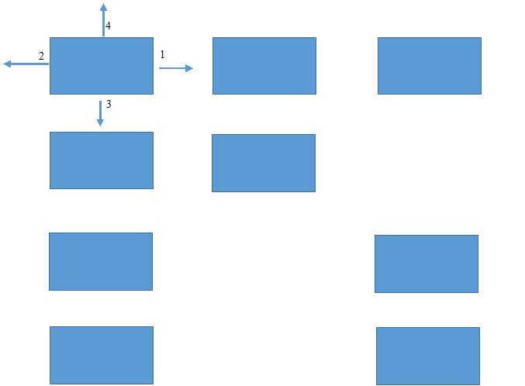
The way of searching for the tables

Slide 8
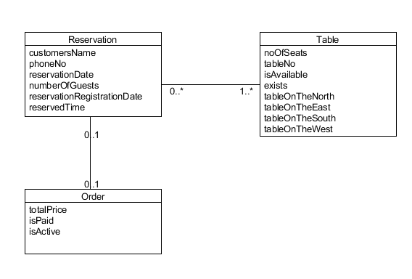
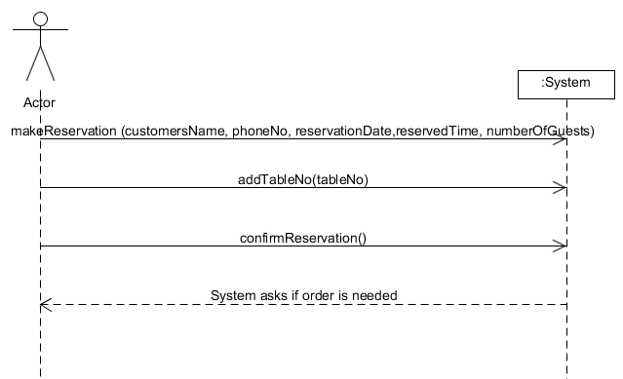
Reservation Use Case
Part Of Domain Model
System Sequence Diagram

Slide 9
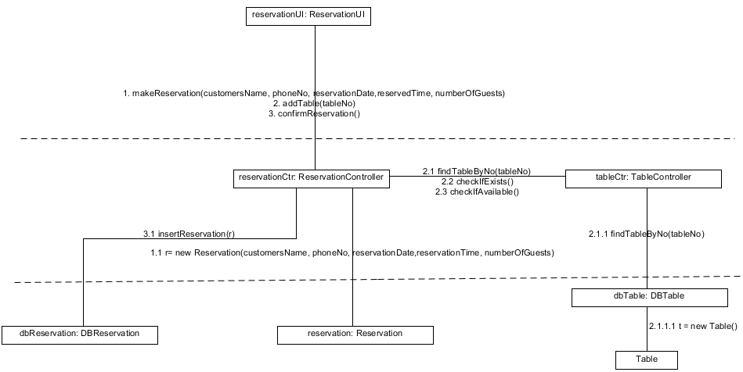
Reservation Use Case
Interaction Diagram

Slide 10
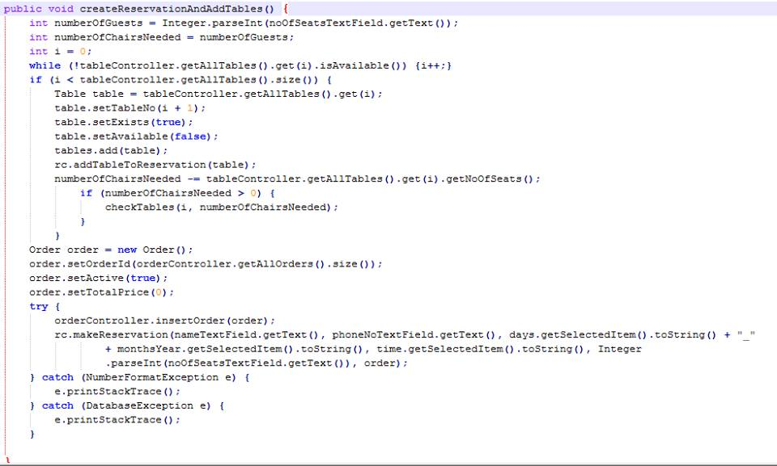
Old Table Search Algorithm (Part Of Make Reservation Use Case)
Code part 1

Slide 11
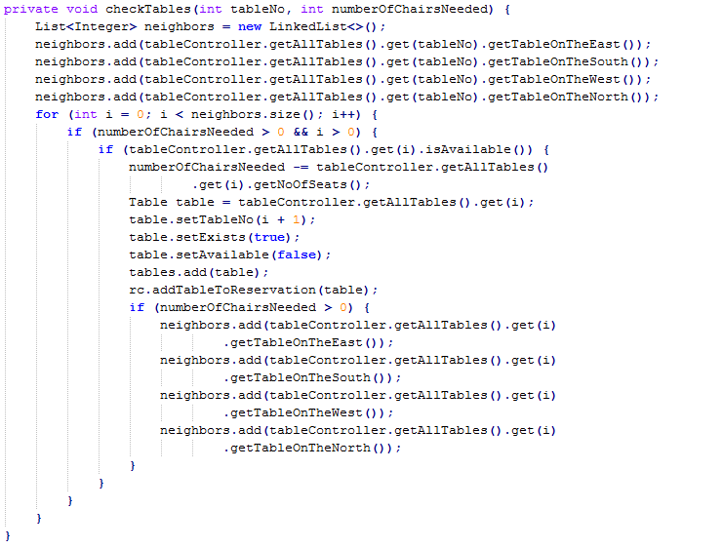
Old Table Search Algorithm (Part Of Make Reservation Use Case)
Code part 2

Slide 12
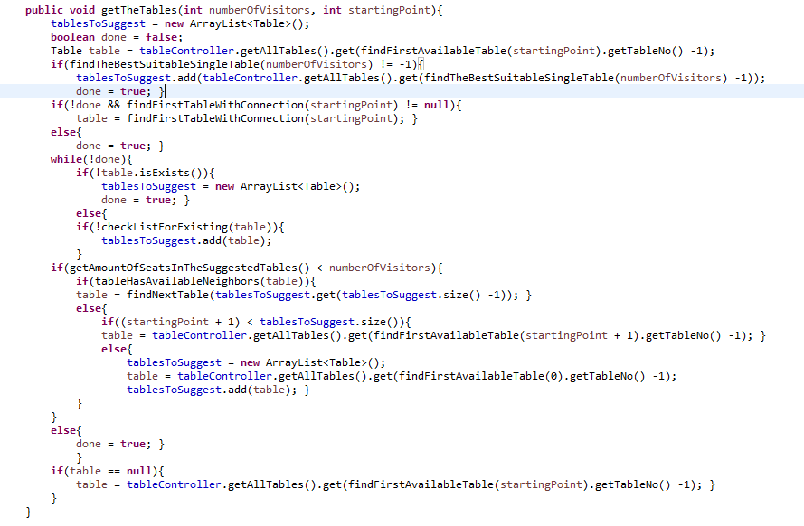
New Table Search Algorithm (Part Of Make Reservation Use Case)
Code part 1

Slide 13
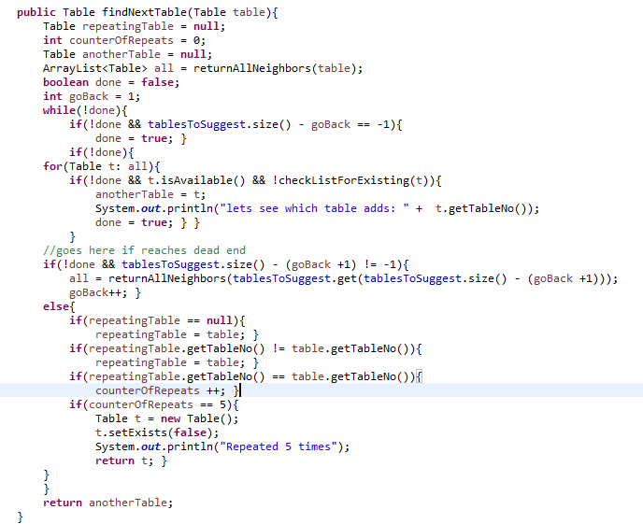
New Table Search Algorithm (Part Of Make Reservation Use Case)
Code part 2

Slide 14
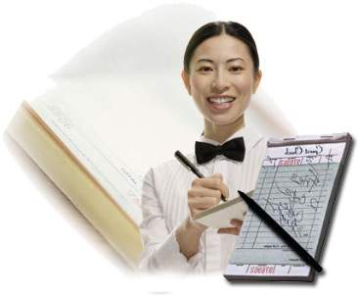
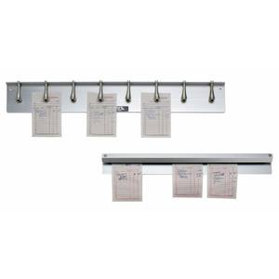
What About The Orders?

Slide 15
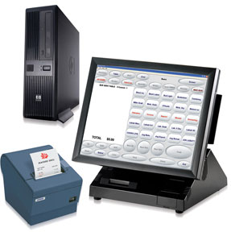

Lets Digitalize this!

Slide 16
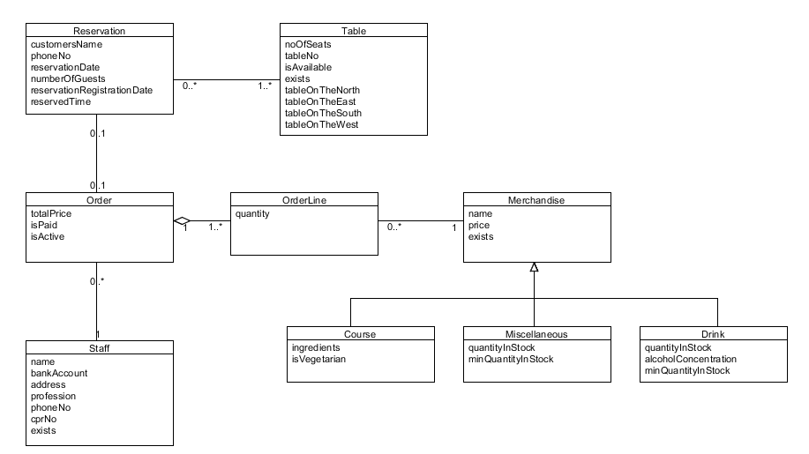
Make Order Use Case
Domain Model

Slide 17
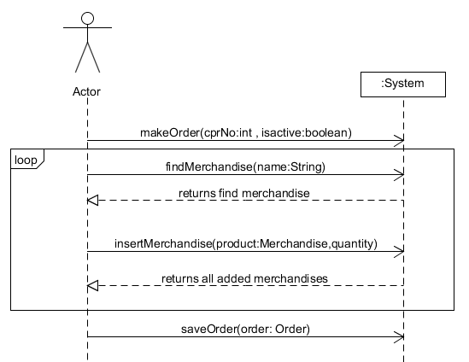
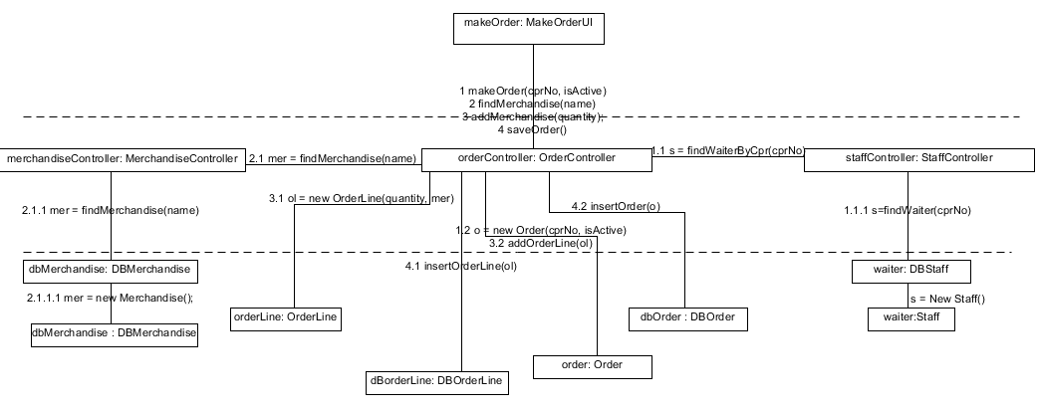
Make Order Use Case
System Sequence Diagram
Interaction Diagram

Slide 18
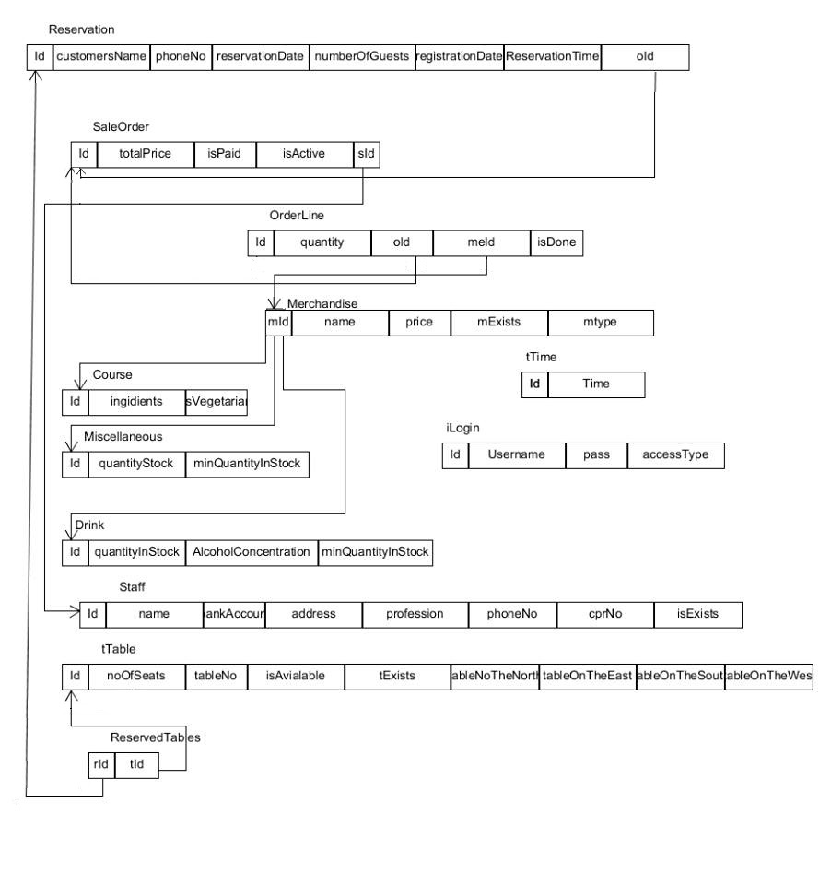
Relational Model

Slide 19

Thank You For Your Attention!

